Slide 1
A Primer on Hedge Funds
MS-FIN Program
Investment Strategies
Professor Werner Bonadurer

Slide 2
Introduction

Slide 3

Hedge Funds - Explorer
Operate on frontiers of markets
(new places, assets, events)
Exploit temporary deviations
from economic value
Analyze structure of
information frontier
Surf on the flow
Search for new waves
Facilitate information diffusion
Always explore new frontiers
Transparency works for
Farmers, not explorers...

Slide 4
Investment Range
Traditional Investments
Cash
Bonds
Equities
Currencies
Commodities
Alternative Investments
Real estate
Hedge Funds
Private Equity
Natural resources
Etc.
Different asset class,
only if
unique risk/return profile

Slide 5
Definition Hedge Funds
„The term hedge fund consists of a number of investment strategies that offer risk and return opportunities not commonly found in traditional long only stock and bond investments. In general, hedge funds are loosely regulated private pooled investment vehicles that manage client assets with trading strategies that are generally levered, often include a performance fee, and use global cash as well as global futures and options markets for the benefit of their investors“ (CISDM)
But the term is a misnomer ... and more of an „everything but“ class

Slide 6
Business Models
 | Traditional Business Model (market-based) | Hedge Fund Business Model (skill-based)
Return objective → this means | Relative to benchmark Capture asset class premium | Absolute, positive return Add value
Risk management → this means | Tracking risk Capture asset class premium | Preserve capital Avoid destroying value
Constraining an active manager might not be the pinnacle of investment wisdom...
Often, hedge funds provide lower investor protection, but higher wealth protection

Slide 7
Hedge Funds vs. Mutual Funds
Criteria | Hedge funds | Mutual funds
Objective | Absolute return | Relative return
Strategies | Large flexibility | Many limitations
Primary sources of return and risk | Strategy and manager selection | Market return
Correlation returns asset markets | Low/limited | High/full
Diversification | As requested | Institutionalized and as offered
Cultural style | Lean and mean | Large and structured
Liquidity | Limitations | Daily liquidity
Transparency | Relatively low | High
Marketing | Limitations | Broad access to retail market
Regulation | Light | Extensive
Business relationship | Manager and client partners | Manager is agent for investor
Minimum investment | High for single fund investments | Low
Compensation and fee structure | Asset-based/ performance-based | Asset-based
Taxation | Pass-through entity | No tax at fund level
Source: Bonadurer (2006)

Slide 8
Hedge Funds vs. Private Equity
Criteria | Hedge funds | Private equity funds
Value creation | Exploit market inefficiencies and pricing anomalies by actively trading; no more than a small interest in single company | Working with or taking over companies in which capital invested; significant influence or control
Type of investment | Often relatively liquid | Usually illiquid
Portfolio diversification | Well-diversified, well-leveraged | Often limited diversification
Investment term | Unlimited | Usually 10 to 15 years
Liquidity (investor perspective) | Open-ended fund structure with withdrawals possible | Closed-end funds with withdrawals only at discretion of fund manager
Contribution | 100 percent contribution at the prevailing subscription price | Contribution is based on capital commitment over time
Fees | Management and performance fees | Management fees and carried interest
Tax and regulatory issues | Special rules apply | Special rules apply
Culture | Traders | Bankers and operators
Size | About a $1.2 trillion business | About a $150 billion business
Source: Bonadurer (2006)

Slide 9
Organization
Business Partnership
General Partner
(Limited Liability Corporation)
Hedge
Fund manager
....
Limited Partner
Investor 1
(Fractional interest)
Limited Partner
Investor 2
(Fractional interest)
Limited Partner
Investor n
(Fractional interest)

Slide 10
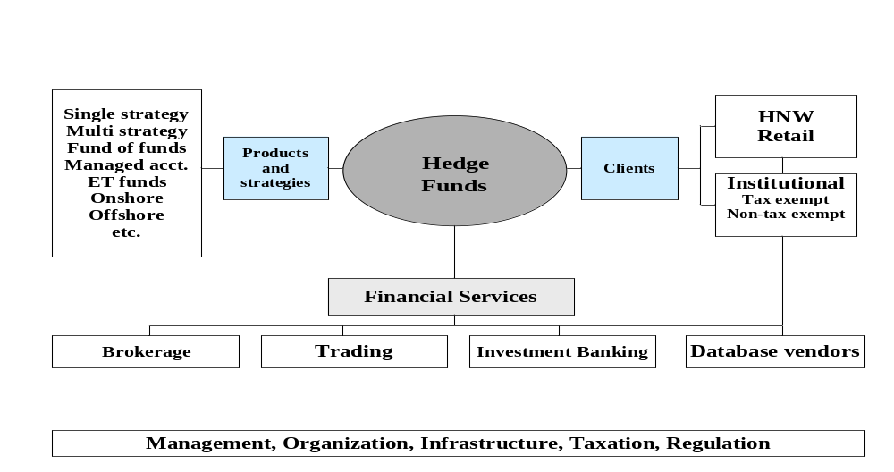
Business Environment
Source: Bonadurer (2006)

Slide 11
Hedge Fund Managers
Hedge
Fund
Manager
Y
Hedge
Fund
Manager
A
Hedge
Fund
Manager
X
Investment
Strategy
1
Investment
Strategy
1
Investment
Strategy
2
Investment
Strategy
n
Hedge
Fund
Manager
X
Hedge
Fund
Manager
Y
Hedge
Fund
Manager
Z
Single manager
Single strategy
Single manager
Multi strategy
Fund of Hedge Funds
Source: Bonadurer (2006)

Slide 12
Market

Slide 13
Growth
Hedge funds grew at a remarkable rate since 1990, from 530 funds with under $39 billion in assets to more than 7,200 funds at the beginning of 2011, with assets of more than $2 trillion, based on the following developments:
  Diversification: Investors were looking for portfolio diversification beyond “long-only” investment funds
  Absolute returns: Most traditional investment funds try to beat market averages such as the S&P 500 Index, claiming excellent management skills if their fund outperforms the relevant index, but if the index return is negative, the outcome would be inferior to a hedge fund that that tries to achieve an absolute return (meaning a return greater than 0%)
  Increased institutional investing: Because university endowments such as Yale’s endowment achieved spectacular returns from investing up to 50% of their entire portfolio in alternative assets such as hedge funds, private equity, real estate and commodities (achieving an average annual return of over 23% between 2001 and 2007), many large institutional investors such as pension funds and other university endowment funds substantially increased their exposure to hedge funds
Source: Investment Banks, Hedge Funds, and Private Equity; David P. Stowell; 2nd ed.; Elsevier

Slide 14
Growth
  Favorable market environment: This period was characterized by a benign credit environment, strong equity market and accommodating tax and regulatory conditions, enabling hedge funds to take advantage of low interest rates and flexible credit leverage to augment returns
  Human capital growth: Hedge funds were able to draw talent from investment banks and asset managers because of very high compensation and the opportunity to be more independent
  Financial innovation: Hedge funds’ ability to execute increasingly complex and high-volume trading strategies was made possible by product and technology innovations in the financial market and by reductions in transaction costs.
  Electronic trading platforms: Direct market access tools for futures and swaps allowed hedge funds to profitably trade a broad range of financial assets, while at the same time, more effectively manage their risks
Source: Investment Banks, Hedge Funds, and Private Equity; David P. Stowell; 2nd ed.; Elsevier

Slide 15
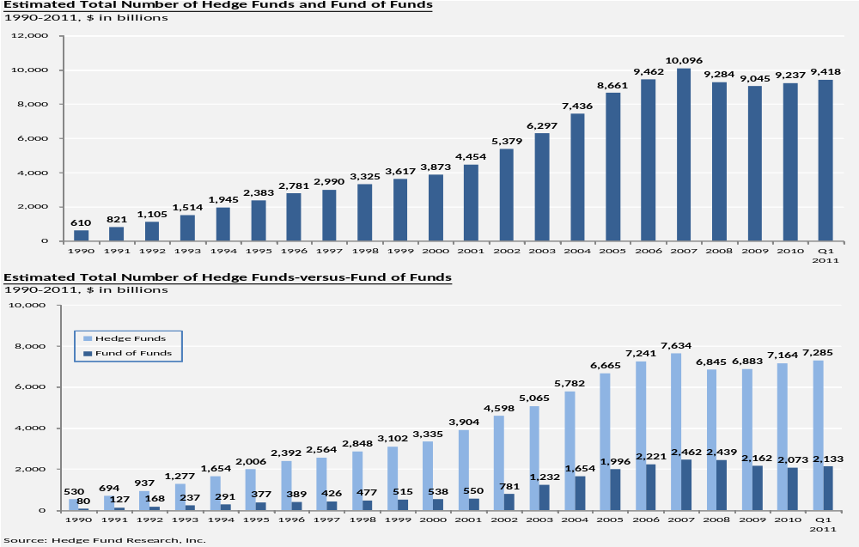
Growth

Slide 16
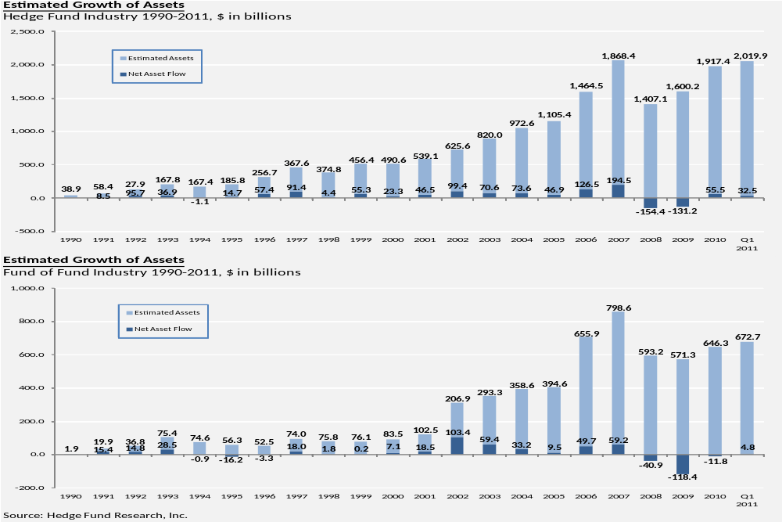
Growth

Slide 17
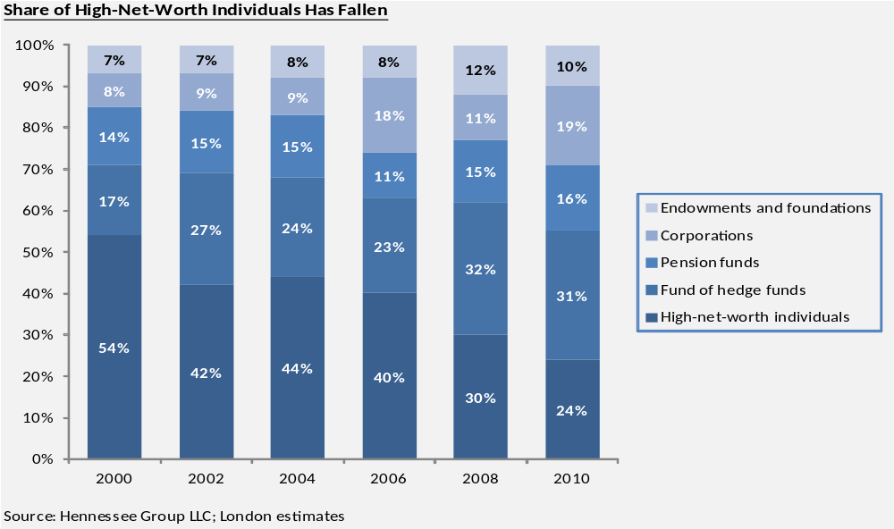
Investors

Slide 18
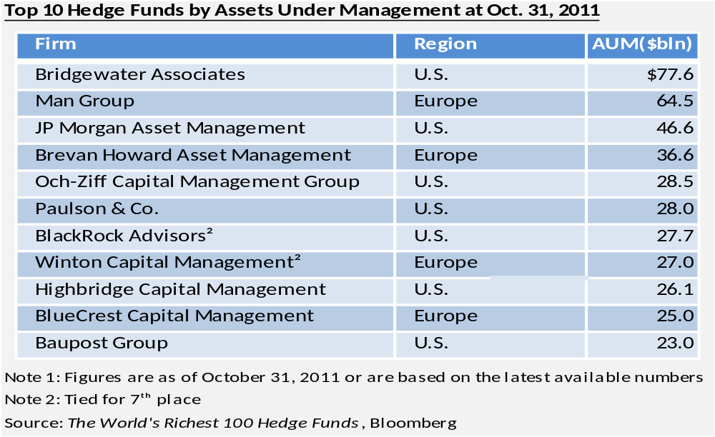
Largest Hedge Funds

Slide 19
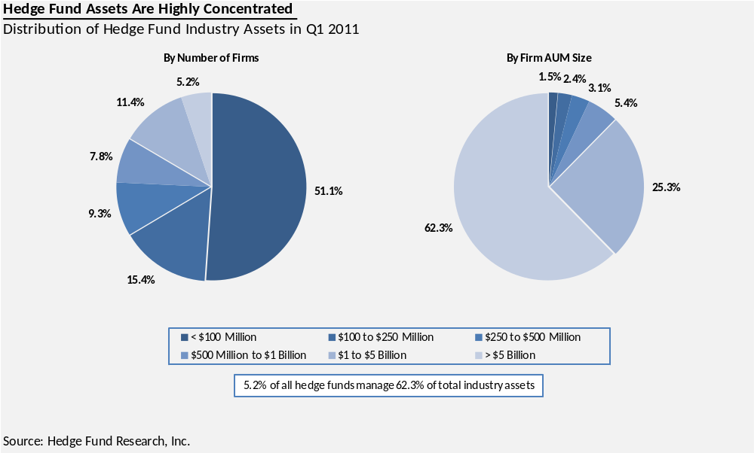
Revenue Concentration

Slide 20
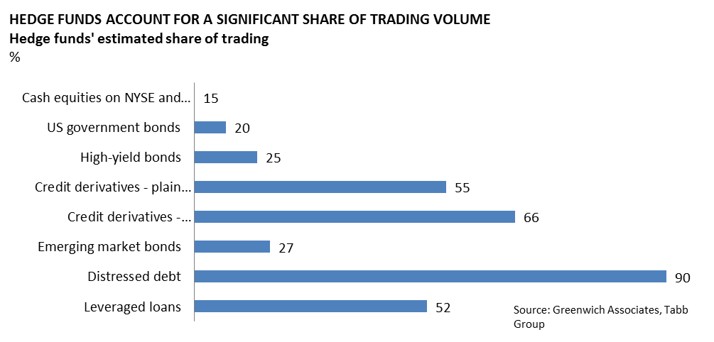
Trading Volume

Slide 21
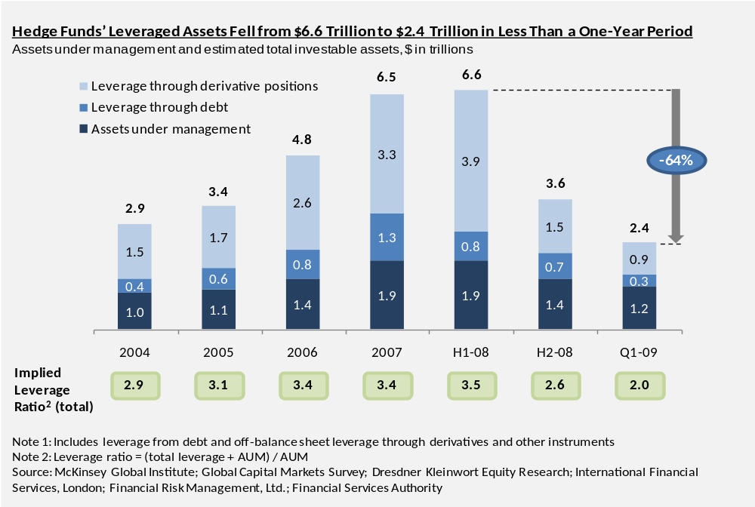
Leverage Dropped During 2008
Notes:
Not anything exactly the same info in Word document

Slide 22
Fee Structure – Single Fund
Mutual Fund
Hedge funds
Fund performance before fees | +10.0% | -10.0% | +12.8% | -9.5%
Management fees (% of assets) | -1.0% | -1.0% | -1.5% | -1.5%
Incentive fees (% of gains) | 0 | 0 | 2.3% Embedded at the money call option value | 0
Fund performance after fees | +9.0% | -11.0% | +9.0% | -11.0%

Slide 23
Trading and Investment Strategies

Slide 24
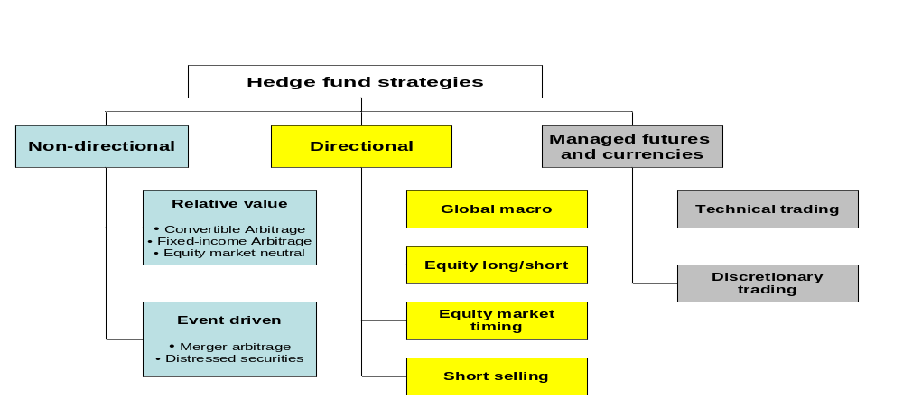
Overview Hedge Fund Styles
Lower Market exposure Higher
Varying
Source: Bonadurer (2006)

Slide 25
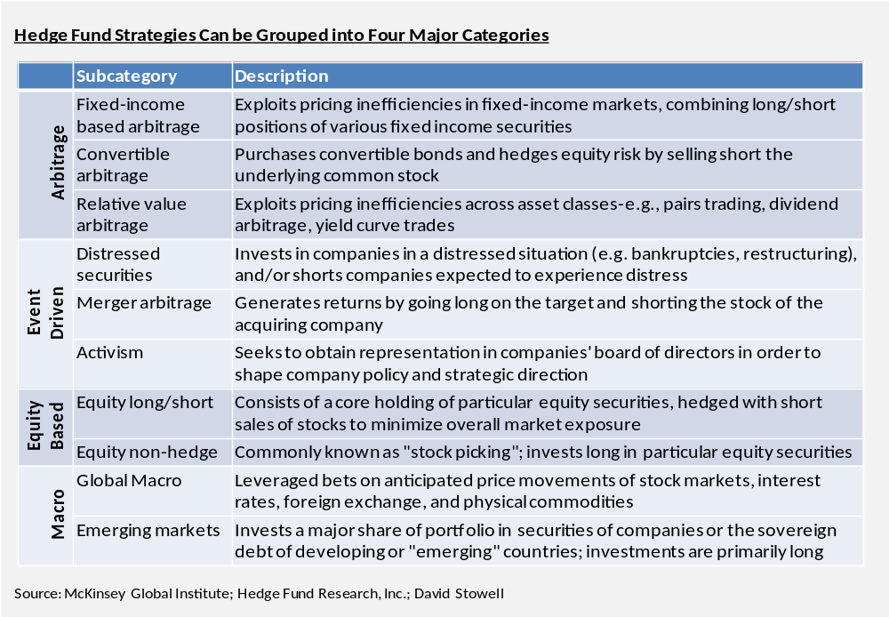
Four Categories

Slide 26
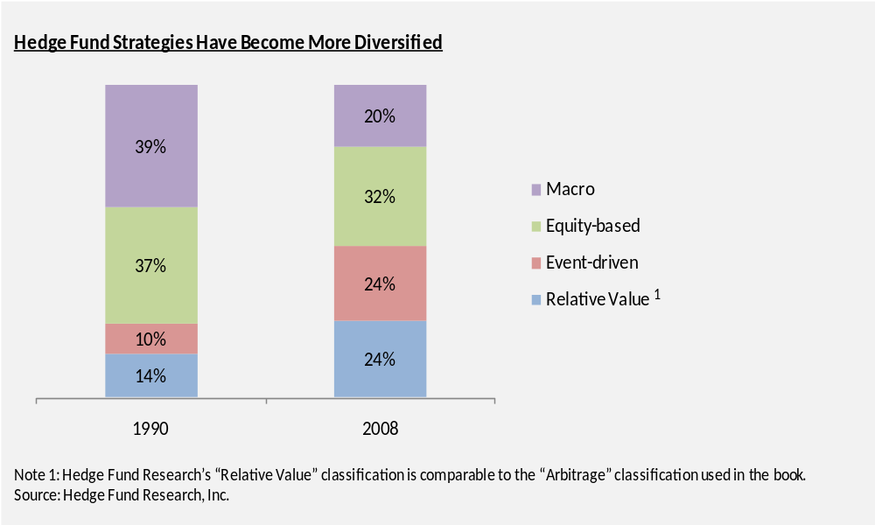
Strategies are Diversified

Slide 27
Alpha Transfer
Separate asset allocation from security selection
  Invest where you find alpha
Hedge the systematic risk to isolate its alpha
Establish exposure to desired market sectors by using passive indexes

Slide 28
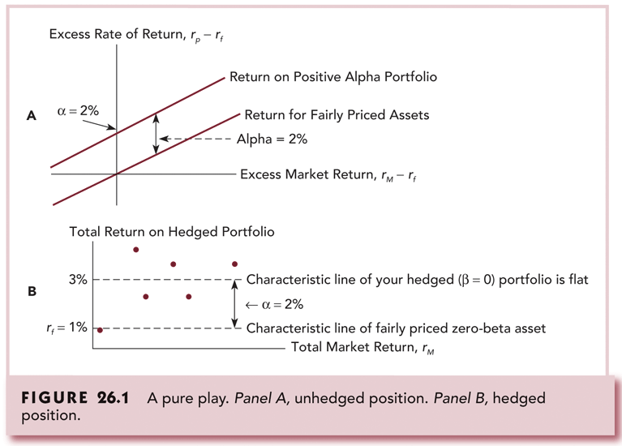
A Pure Play. Panel A, Unhedged
Position. Panel B, Hedged Position

Slide 29
A.W. Jones Theory
Equity Long/Short Hedge Funds
Two unique risks
Idiosyncratic risk
General market risk
Expected
return
Long
position
*
„Arbitrage in expectations“
Buy undervalued securities
Sell short overvalued securities
Market neutral investment
Expect price conversion
Arbitrage
spread
*
Short
position
Market
Exposure
(e.g. beta)

Slide 30
Equity Long/Short
A hedge fund manager that focuses on equity long/short investing starts with a fundamental analysis of individual companies, combined with research on risks and opportunities particular to a company’s industry, country of incorporation, competitors and the overall macroeconomic environment in which the company operates
This strategy attempts to shift the principal risk from market risk to manager risk, which requires skilled stock selection to generate alpha through a concurrent purchase and sale of similar securities in an attempt to exploit relative mispricings, while decreasing market risk
Managers consider ways to reduce volatility by either diversifying or hedging positions across industries and regions and hedging un-diversifiable market risk
However, the overall risk in this strategy is determined by whether a manager is attempting to prioritize returns (by having more concentration and leverage) or low risk (by creating lower volatility through diversification, lower leverage and hedging)
Source: Investment Banks, Hedge Funds, and Private Equity; David P. Stowell; 2nd ed.; Elsevier

Slide 31
Equity Long/Short
Relative Mispricing -- Example
Analysis
In outcome 1 and 2: PB = 3*PA
But now: PB > 3*PA
Imbalance!
...1 stock B should equal 3 stocks A
Law of one price violated!
Stock A is undervalued relative to stock B
→ Arbitrage opportunity
Outcome 1
PA=$ 45
PB=$135
Now
PA=$ 38
PB=$120
Outcome 2
PA=$30
PB=$90
Arbitrage strategy – Cash flows
Now Outcome 1 Outcome 2
Buy 3 stocks A ($114) $135 Sell 3 stocks A $90
Sell short 1 stock B $120 ($135) Cover short ($90)
Net cash flow $6 $0 $0
Example from Billingsley (2006) Strongly simplified and ignoring transactions costs, margin requirements, dividends, etc.

Slide 32
Equity Long/Short
Absolute Mispricing – Example
Example with two well-diversified equity portfolios A and B with
the same beta coefficient (1.2)
E(R)
Portfolio A and B same risk →
Should have same expected return
Asset A correctly priced
E(R) asset B too high (price too low)
Asset B is undervalued
Law of one expected return violated
SML
17%
B
*
15%
A
*
6%
R_{f}
1.2
Beta
Arbitrage:
Sell short asset A and buy asset B
Initial net cash inflow and no change in risk
Example from Billingsley (2006)

Slide 33
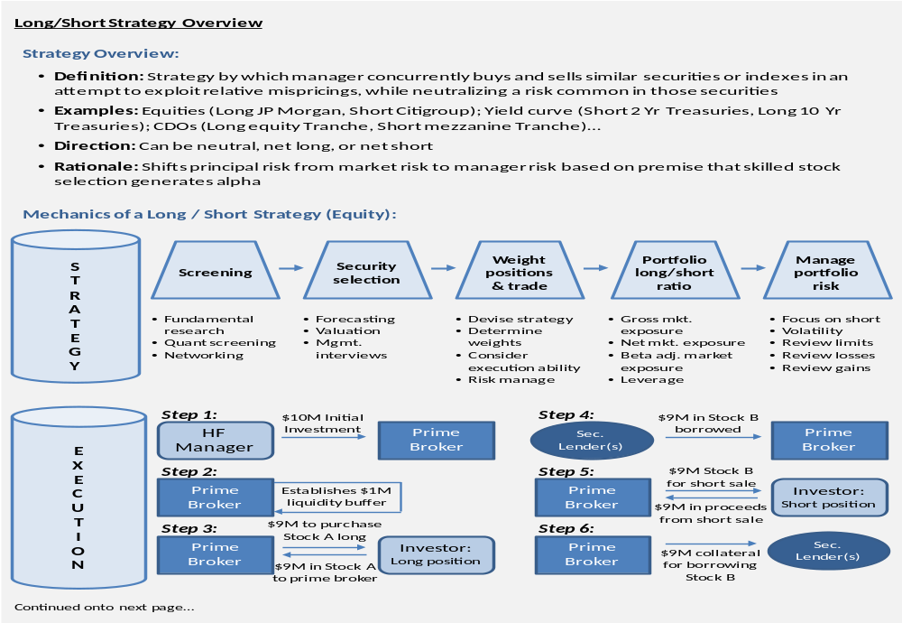
Equity Long/Short
Source: Investment Banks, Hedge Funds, and Private Equity; David P. Stowell; 2nd ed.; Elsevier

Slide 34
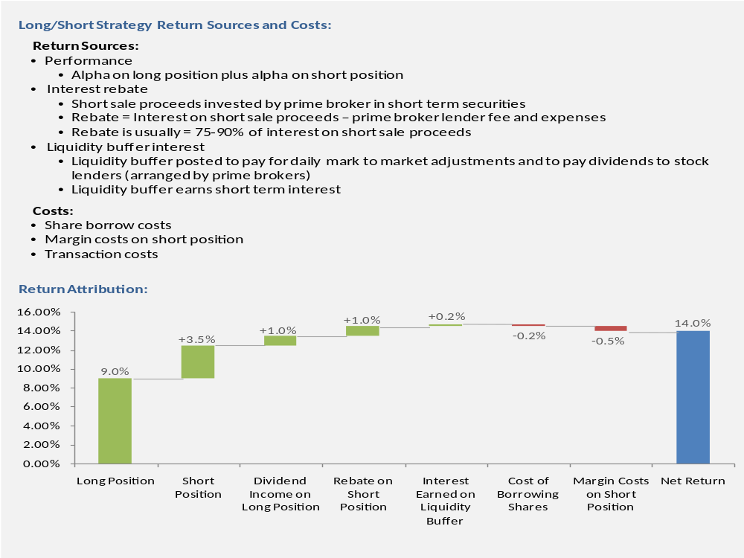
Equity Long/Short
Source: Investment Banks, Hedge Funds, and Private Equity; David P. Stowell; 2nd ed.; Elsevier

Slide 35
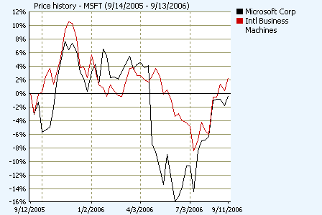
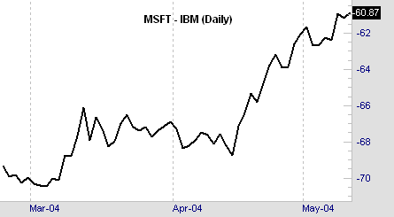
Equities Spread Trading
Example
Sudden spread narrowing
Source: Datastream
Signal?

Slide 36
Global Macro
A macro focused hedge fund makes leveraged bets on anticipated price movements in stock and bond markets, interest rates, foreign exchange and physical commodities
This strategy also takes positions in financial derivatives such as forwards, options and swaps on assets such as stocks, bonds, commodities, loans, and real estate and on indexes that are focused on interest rates, stock and bond markets, exchange rates, and instruments that relate to inflation
A macro-focused fund considers economic forecasts, analysis about global flow of funds, interest rate trends, political changes, relations between governments, individual country political and economic policies and other broad systemic considerations
A well-known practitioner of a global macro investment is George Soros, who sold short more than $10 billion of pound sterling in 1992, successfully profiting from the Bank of England’s reluctance to either raise its interest rates to levels comparable to rates in other European countries or to float its currency
Source: Investment Banks, Hedge Funds, and Private Equity; David P. Stowell; 2nd ed.; Elsevier

Slide 37
Emerging Markets
An emerging market focused hedge fund invests most of its funds in either the securities of companies in developing (emerging) countries or the sovereign debt of these countries
Emerging markets is a term used to describe a country’s social or business activity that is characterized by rapid growth and industrialization
Typically investors demand greater returns because of incremental risks
Source: Investment Banks, Hedge Funds, and Private Equity; David P. Stowell; 2nd ed.; Elsevier

Slide 38
Arbitrage Defined
(Pure) Arbitrage is the process of earning a riskless profit by taking advantage of different prices for the same good, whether priced alone or in equivalent combinations.
A true arbitrage opportunity exists when simultaneous positions can be taken in assets that earn a net positive return without exposing the investor to risk and without requiring a net cash outlay.
The law of one price/law of one expected return defines the resting
place for an asset‘s price, arbitrage is the action/process that draws prices to that spot
Source: Billingsley (2006)

Slide 39
Arbitrage – Risky Variations
„True“ arbitrage is riskless and self-financing, but there are risky variations:
Risk arbitrage (e.g. merger arbitrage)
Equity long/short arbitrage
Pairs trading arbitrage (e.g. relative spread trading)
Index arbitrage
Capital structure arbitrage
Etc.
Tax arbitrage
Regulatory arbitrage
Etc.

Slide 40
Fixed Income Arbitrage
Fixed income arbitrage funds attempt to exploit pricing inefficiencies in fixed income markets by combining long/short positions of various fixed income securities
For example, historically, because of the limited liquidity of the Italian bond futures market, the currency-hedged returns from this market in the short term were lower than the short-term returns in the very liquid U.S. Treasury bond market
However, over a longer period of time, the hedged returns became nearly identical
Fixed income arbitrageurs benefitted from the eventual convergence of hedged yields between currency-hedged Italian bond futures and U.S. Treasury bonds by shorting relatively expensive U.S. Treasury bonds and purchasing relatively cheap Italian bond futures
Source: Investment Banks, Hedge Funds, and Private Equity; David P. Stowell; 2nd ed.; Elsevier

Slide 41
Fixed Income Arbitrage
Another example involves 30-year on-the-run and off-the-run U.S. Treasury bonds
Liquidity discrepancies between the most recently issued 30-year Treasury bonds (called on-the-run bonds) and 29.75 year Treasury bonds that were originally issued one quarter earlier (called off-the-run bonds) sometimes causes a slight difference in pricing between the two bonds
This can be exploited by buying cheaper off-the-run bonds and shorting the more expensive on-the-run bonds
Since the price of the two bonds should converge within three months (both bonds becoming off-the-run bonds), this trading position should create a profit for the arbitrageur
Source: Investment Banks, Hedge Funds, and Private Equity; David P. Stowell; 2nd ed.; Elsevier

Slide 42
Convertible Arbitrage
A convertible bond can be thought of as a fixed-income security that has an embedded equity call option
The convertible investor has the right, but not the obligation to convert (exchange) the bond into a predetermined number of common shares
he investor will presumably convert sometime at or before the maturity of the bond if the value of the common shares exceeds the cash redemption value of the bond
The convertible therefore has both debt and equity characteristics and, as a result, provides an asymmetrical risk and return profile
Until the investor converts the bond into common shares of the issuer, the issuer is obligated to pay a fixed coupon to the investor and repay the bond at maturity if conversion never occurs
A convertible’s price is sensitive to, among other things, changes in market interest rates, credit risk of the issuer, and the issuer’s common share price and share price volatility
Source: Investment Banks, Hedge Funds, and Private Equity; David P. Stowell; 2nd ed.; Elsevier

Slide 43
Convertible Arbitrage
Convertible Arbitrage is a market neutral investment strategy that involves the simultaneous purchase of convertible securities and the short sale of common shares (selling borrowed stock) that underlie the convertible
An investor attempts to exploit inefficiencies in the pricing of the convertible in relation to the security’s embedded call option on the convertible issuer’s common stock
In addition, there are cash flows associated with the arbitrage position that combine with the security’s inefficient pricing to create favorable returns to an investor who is able to properly manage a hedge position through a dynamic hedging process
The hedge involves selling short a percentage of the shares that the convertible can convert into based on the change in the convertible’s price with respect to the change in the underlying common stock price (delta) and the change in delta with respect to the change in the underlying common stock (gamma)
Source: Investment Banks, Hedge Funds, and Private Equity; David P. Stowell; 2nd ed.; Elsevier

Slide 44
Convertible Arbitrage
The short position must be adjusted frequently in an attempt to neutralize the impact of changing common share prices during the life of the convertible security (this process of managing the short position in the issuer’s stock is called “delta hedging”)
If hedging is done properly, whenever the convertible issuer’s common share price decreases, the gain from the short stock position should exceed the loss from the convertible holding, and whenever the issuer’s common share price increases, the gain from the convertible holding should exceed the loss from the short stock position
The investor will also receive the convertible’s coupon payment and interest income associated with the short stock sale
However, this cash flow is reduced by paying a cash amount to stock lenders equal to the dividend the lenders would have received if the stock were not loaned to the convertible investor, and further reduced by stock borrow costs and interest expense on any borrowings to finance the investment
Source: Investment Banks, Hedge Funds, and Private Equity; David P. Stowell; 2nd ed.; Elsevier

Slide 45
Relative Value Arbitrage
Relative value arbitrage exploits pricing inefficiencies across asset classes
An example of this is “pairs trading”, which involves two companies that are competitors or peers in the same industry that have stocks with a strong historical correlation in daily stock price movements
When this correlation breaks down (one stock increases in price while the other stock decreases in price) a pairs trader will sell short the outperforming stock and buy the underperforming stock, betting that the “spread” between the two stocks will eventually converge
When, and if, convergence occurs, there can be significant trading profits
Of course, if divergence occurs, notwithstanding the strong historical correlations, this trade can lose money
Source: Investment Banks, Hedge Funds, and Private Equity; David P. Stowell; 2nd ed.; Elsevier

Slide 46
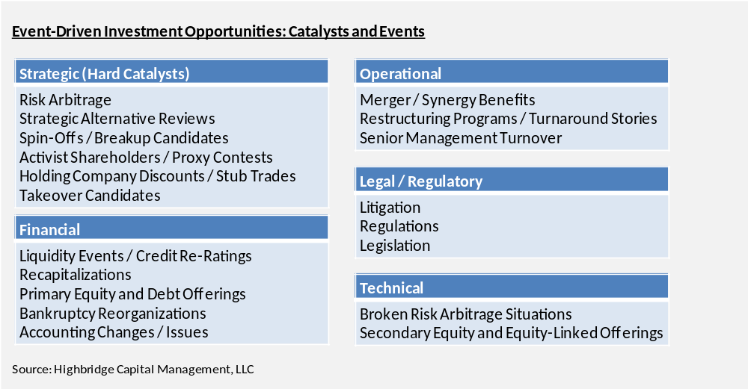
Event Driven Strategies
Event driven strategies focus on significant transactional events such as M&A transactions, bankruptcy reorganizations, recapitalizations and other specific corporate events that create pricing inefficiencies

Slide 47
Activist Investors
Activist investors take minority equity or equity derivative positions in a company and then try to influence the company’s senior management and board to consider initiatives that the activist considers important in order to enhance shareholder value
This strategy is sometimes called Shareholder Activism
Activist investors often attempt to influence other major investors to support their recommendation to the company, which sometimes leads to proxy solicitations designed to change the management composition of the company
Activist investors commonly push for lower costs, lower cash balances, greater share repurchases, higher dividends and increased debt, among other things
Source: Investment Banks, Hedge Funds, and Private Equity; David P. Stowell; 2nd ed.; Elsevier

Slide 48
Merger Arbitrage
Introduction
Changes in corporate control (merger, tender offer)
Cash, stock-for-stock, or complex transactions
Usually tender offer price > share price target
Arbitrage exploits merger spread
  Selling short stock acquiring company
  Buying stock of aquiree
Fundamental research-driven analysis
Distinct risk/return profile
Low correlation to market returns?

Slide 49
Merger Arbitrage
In a stock-for-stock acquisition, some traders will buy the target company’s stock and simultaneously short the acquiring company’s stock, creating a “risk arb” position that is called Merger Arbitrage or Risk Arbitrage
The purchase is motivated by the fact that after announcement of a pending acquisition, the target company’s share price typically trades at a lower price in the market compared to the price reflected by the Exchange Ratio that will apply at the time of closing
Traders who expect that the closing will eventually occur can make trading profits by buying the target company’s stock and then receiving the acquiring company’s stock at closing, creating value in excess of their purchase cost
To hedge against a potential drop in value of the acquiring company’s stock, the trader sells short the same number of shares to be received at closing in the acquiring company’s stock based on the Exchange Ratio
Risk arb trading puts downward pressure on the acquiring company’s stock and upward pressure on the selling company’s stock
Source: Investment Banks, Hedge Funds, and Private Equity; David P. Stowell; 2nd ed.; Elsevier

Slide 50
Merger Arbitrage
As an example, if an acquiring company agrees to purchase a target company’s stock at an Exchange Ratio of 1.5x, then at closing, the acquirer will deliver 1.5 shares for every share of the target’s stock
Assume that just prior to when the transaction is announced, the target’s stock price is $25, the acquirer’s stock is $20, and it will be six months until the transaction closes
Since 1.5 acquirer shares will be delivered, the value to be received by target company shareholders is $30 per share
However, because there is some probability the acquisition doesn’t close in 6 months, the target company stock will likely trade below $30 until the date of closing
Source: Investment Banks, Hedge Funds, and Private Equity; David P. Stowell; 2nd ed.; Elsevier

Slide 51
Merger Arbitrage
If the target stock trades at, for example, $28 after announcement, for every share of target stock that risk arbs purchase at $28, they will simultaneously short 1.5 shares of the acquirer’s stock
This trade enables risk arbs to profit from the probable increase in the target’s share price up to $30, assuming the closing takes place, while hedging its position (the shares received by risk arbs at closing will be delivered to the parties that originally lent shares to them)
The objective for risk arbs is to capture the spread between the target company’s share price after announcement of the deal and the offer price for the target company, as established by the Exchange Ratio, without exposure to a potential drop in the acquirer’s share price
However, if the transaction doesn’t close or the terms change, the risk arbs’ position becomes problematic and presents either a diminution in profit or a potential loss
Source: Investment Banks, Hedge Funds, and Private Equity; David P. Stowell; 2nd ed.; Elsevier

Slide 52
Merger Arbitrage
Example
Buyer
Wachovia (WB)
Share price
May 7, 2006
$54.16
Target
Golden West Fin. (GWF)
Share price
May 7, 2006
$74.04
Transaction agreement
May 7, 2006
1 GWF share
for
1.051 shares WB
and
$ 18.65 cash
Value „package“:
(1.051*$54.16)+$18.65 = $75.57/share
Premium: 2.07% (merger spread)
May 7, 2006 Arbitrage cash flows June 30, 2006 (closing)
Buy 1000 GWF at $74.04 = ($74,040) Tender 1000 GWF
Sell short 1051 WB at $54.16 = $56,922 Receive 1051 WB (close out short)
Borrow funds = $17,118 Receive $18,650 (close out credit)
Profit: $1,532
Source: modified from www.arbitrage.com

Slide 53
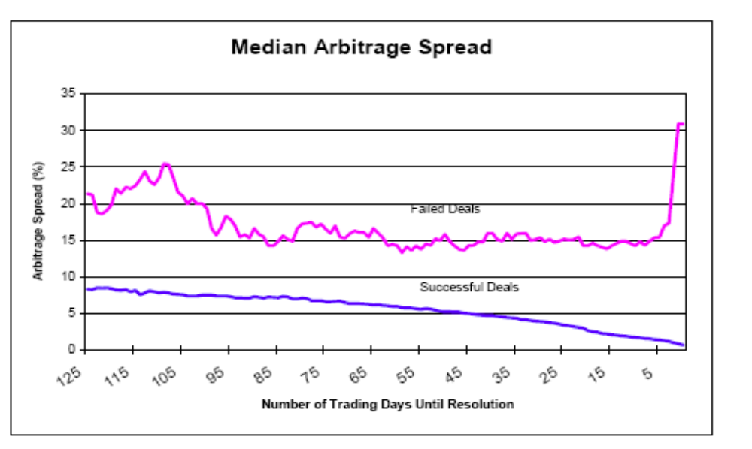
Merger Arbitrage Spread
Arbitrage spread = (Offer price – Target price) / Target price
Source: Mitchell and Pulvino (2001)

Slide 54
Merger Arbitrage
Blown Deals
If deal called off, usually
Stock Target (long position) down Stock Buyer (short position) up
Fundamental
Analysis
valuation
market
competition
other bidders
legal
regulatory
anti-trust
etc.
Deal A | Probability | Payoff
Deal succeeds | 90% | + 2%
Deal blows up | 10% | - 20%
What if playing this game 1000 times? Portfolio implications?
Source: modified from www.arbitrage.com

Slide 55
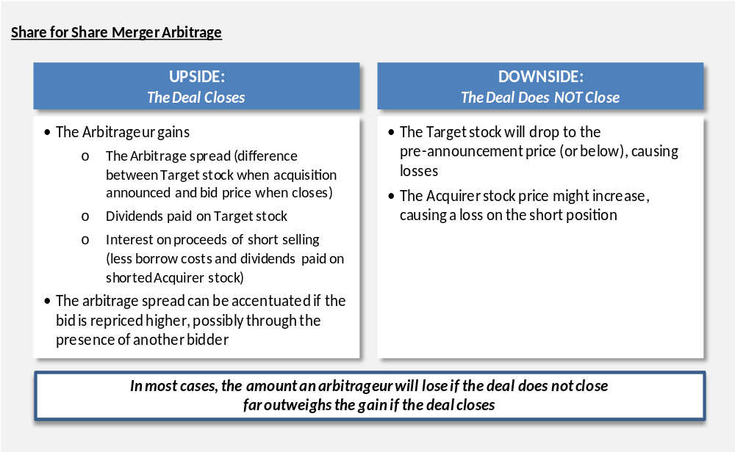
Merger Arbitrage

Slide 56
Merger Arbitrage
Risks
Predominantely a deal-closing risk
Regulatory interference risk
Lack of shareholder approval risk
Financial market risk
Funding risk
Adverse due diligence risk
Adverse material event risk
Low correlation with market ..., really?

Slide 57
Summary
Merger Arbitrage
Historic risk-adjusted returns ~ 4% p.a.
Linear asset pricing models fail to capture true risk
Strong Lepokurtosis (i.e. fat tails) in distribution
  Small number of big losses
  Selling disaster insurance
State-dependent correlation properties
  Low/high correlation in positive/negative equity markets
Short uncovered put options on market indices
  To measure risk-adjusted performance
  To establish an alternative benchmark
  To replicate investment strategy

Slide 58
Distressed Securities
Distressed securities investment strategies are directed at companies in distressed situations such as bankruptcies and restructurings or companies that are expected to experience distress in the future
Distressed securities are stocks, bonds and trade or financial claims of companies in, or about to enter or exit, bankruptcy or financial distress
The prices of these securities fall in anticipation of financial distress when their holders choose to sell rather than remain invested in a financially troubled company (and there is a lack of buyers)
If a company that is already distressed appears ready to emerge from this condition, the prices of the company’s securities may increase
Due to the market’s inability to always properly value these securities, and the inability of many institutional investors to own distressed securities, these securities can sometimes be purchased at significant discounts to their risk adjusted value
Source: Investment Banks, Hedge Funds, and Private Equity; David P. Stowell; 2nd ed.; Elsevier

Slide 59
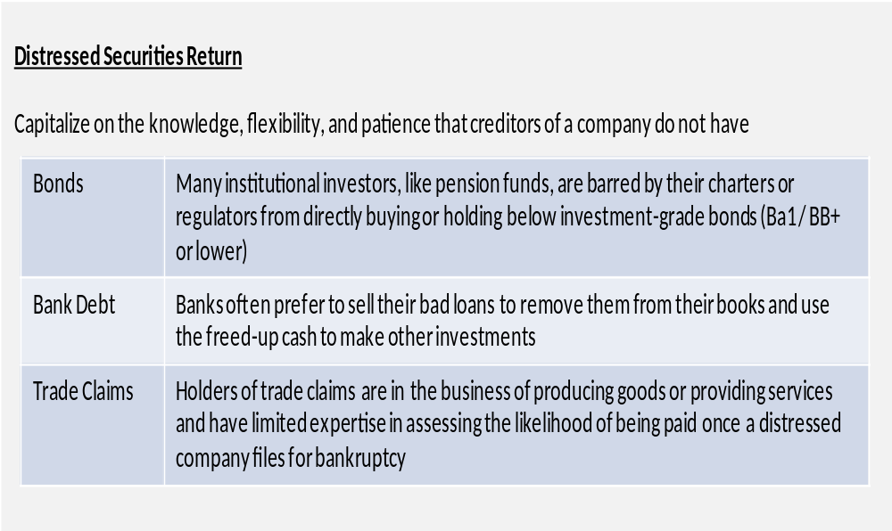
Distressed Securities
Source: Investment Banks, Hedge Funds, and Private Equity; David P. Stowell; 2nd ed.; Elsevier

Slide 60
Returns and Performance

Slide 61
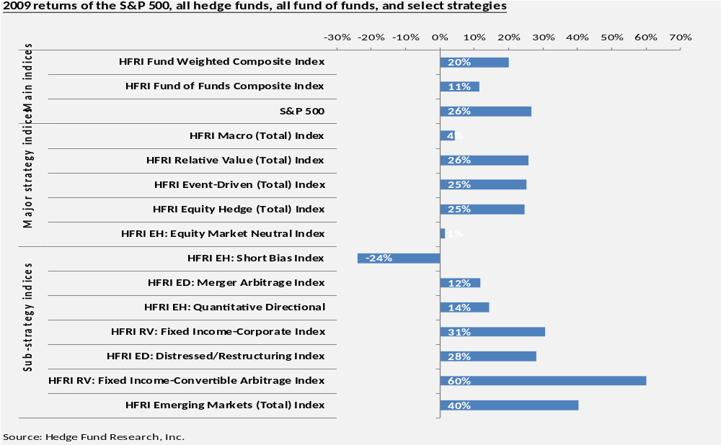
Returns

Slide 62
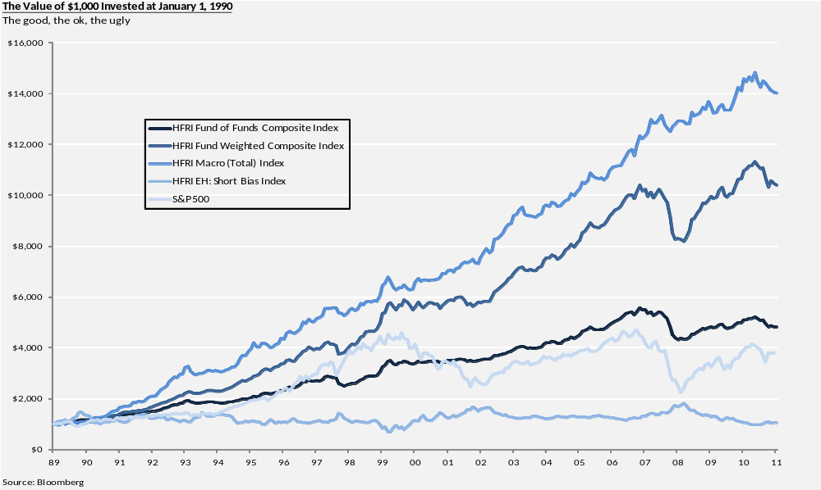
Returns

Slide 63
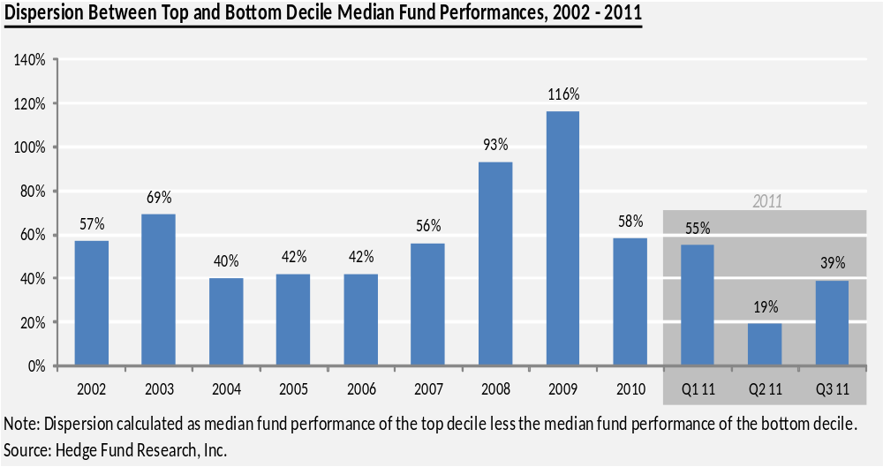
Returns

Slide 64
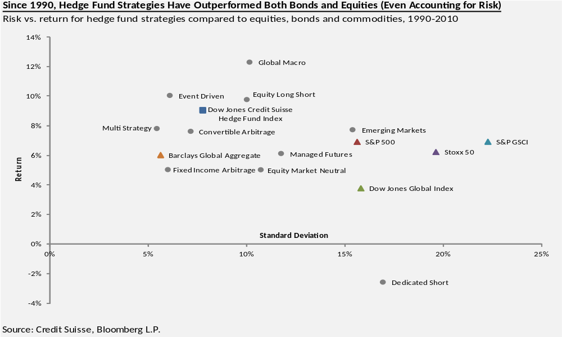
Returns and SD

Slide 65
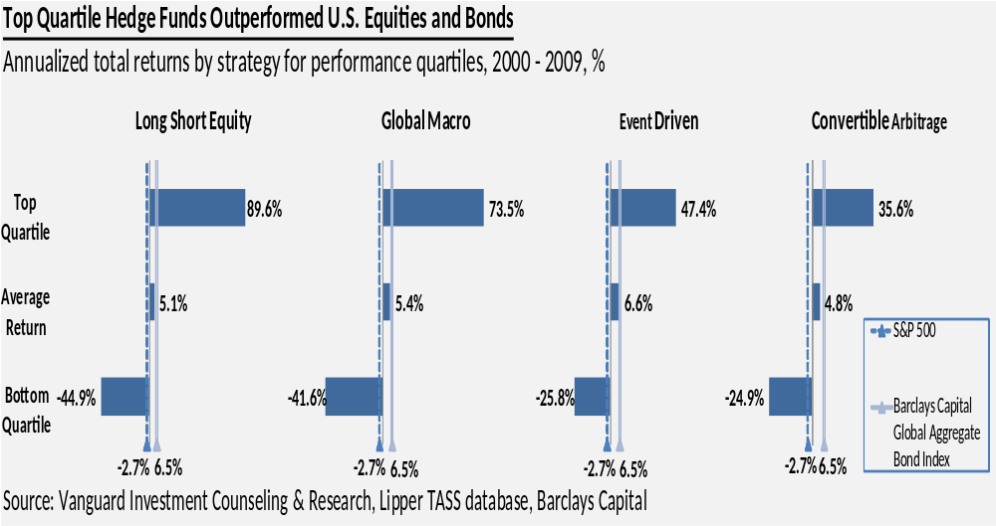
Returns

Slide 66
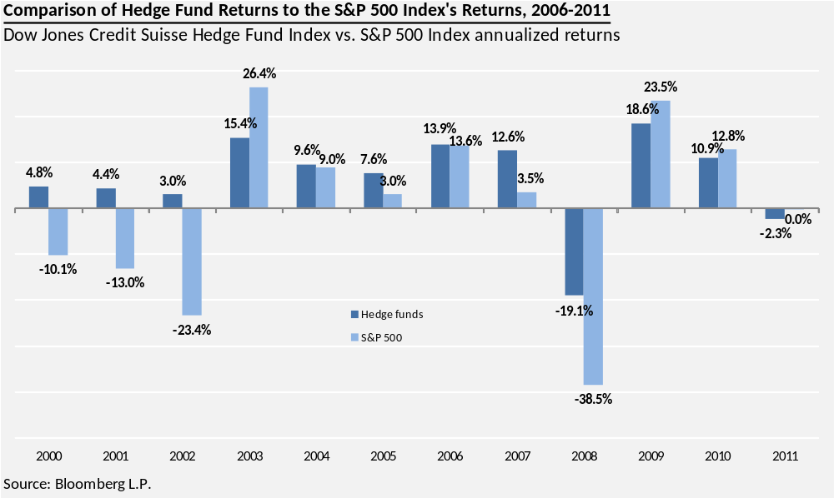
Returns

Slide 67
Searching For Returns
Hedge funds have traditionally been associated with “alpha based” returns which are independent of market conditions, but, increasingly, hedge funds participate in the same investment activity as traditional fund managers
To differentiate themselves, hedge fund managers have had to search for new sources of returns in new markets, but this search has pushed them into less liquid investments, including private equity investments and other private transactions
This activity extends their investment horizon, requires longer lock-ups and results in the need to hire new managers who have long-term investment expertise
Hedge funds have become active participants in leveraged bank loans, mezzanine financings, insurance-linked securities and in LBO transactions
In other words, hedge funds have moved a significant amount of their investment base from public transactions to private transactions in their search for alpha-based returns
Source: Investment Banks, Hedge Funds, and Private Equity; David P. Stowell; 2nd ed.; Elsevier

Slide 68
Challenges
Performance Evaluation
Transparency and representation
Quality performance reporting
Data base biases (up to 3% - 5% p.a.)
Benchmark selection
Index construction
Unadjusted and risk-adjusted reporting
Linear measurement models; ratio models
Performance persistence

Slide 69
Basis Hedge Fund Returns
Betas
Risk premia – Systemic risks
asset price risk, volatility risk, correlation
risk, spread risk, option risk, credit risk,
forex risk, liquidity risk, complexitiy risk,
model risk, event risk,
etc.
+
Alpha
Manager skill – Value added
security selection, market timing,
pricing model, execution, etc.
= Hedge fund investment return
Source: Bonadurer (2006)

Slide 70
Hedge Funds Risk Factors
Market-related
prices
volatility
correlation
spread
credit
liquidity
event
systemic
etc.
Non-market related
leverage
concentration
model
pricing
transparecny
capacity
regulatory
legal
etc.
Operational
manager
talent
risk management
controls
compliance
operations
systems
etc.

Slide 71
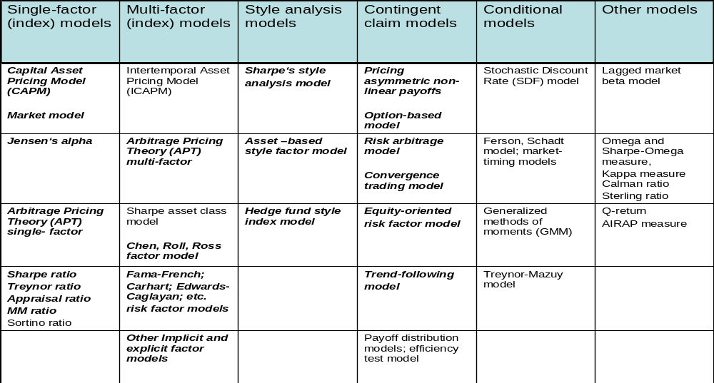
Overview Investment Fund
Performance Models
Source: Bonadurer 2006

Slide 72
Interim Summary
Hedge Funds
Heterogenous investment styles
Difficult performance evaluation
Positive risk-adj. performance (...)
True returns mainly beta-driven
Excellent portfolio asset, if ...
Expensive fund of funds
New frontiers, but not new paradigm

Slide 73
Cloning and Replication

Slide 74
Passive Replicating Portfolios
(Cloning)
Assumed benefits include:
Lower costs (no management fees)
Higher liquidity (exchange-traded instruments)
No capacity constraints
Better transparency
Improved risk management
Portable beta important source of expected return
But:
Difficulty replicating strategies with genuine alpha
Limitations of linear cloning models
Potentially more trading-intensive as expected
Performance may or may not be better...

Slide 75
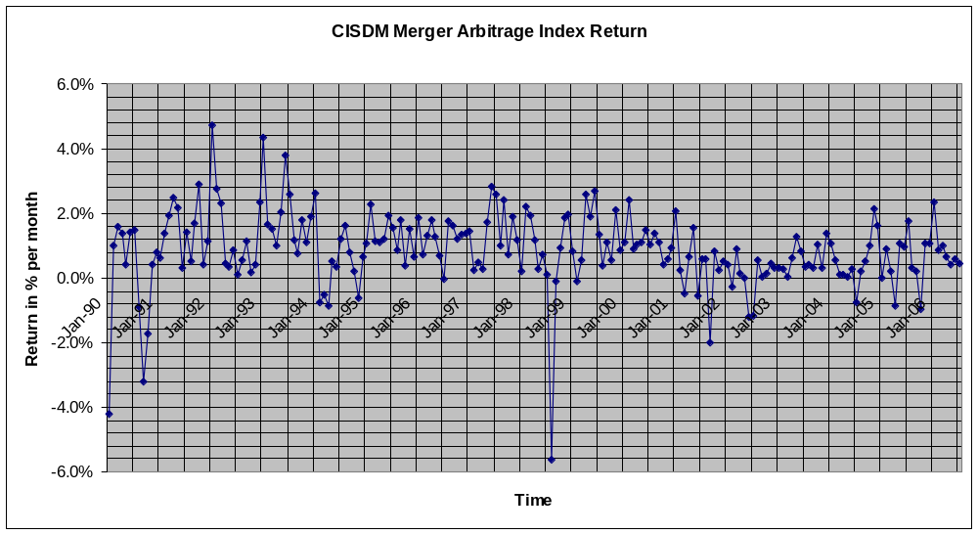
Merger Arbitrage Performance
Source: CISDM (2006)

Slide 76
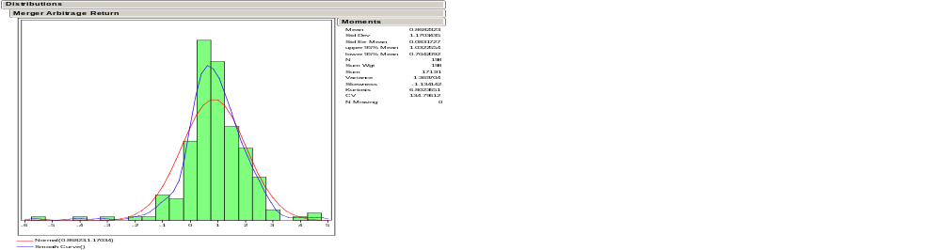
Merger Arbitrage Performance
Return time series 1990 to 2006
CISDM Merger Arbitrage Index
Return in % per month
Source: Bonadurer (2006) based on CISDM

Slide 77
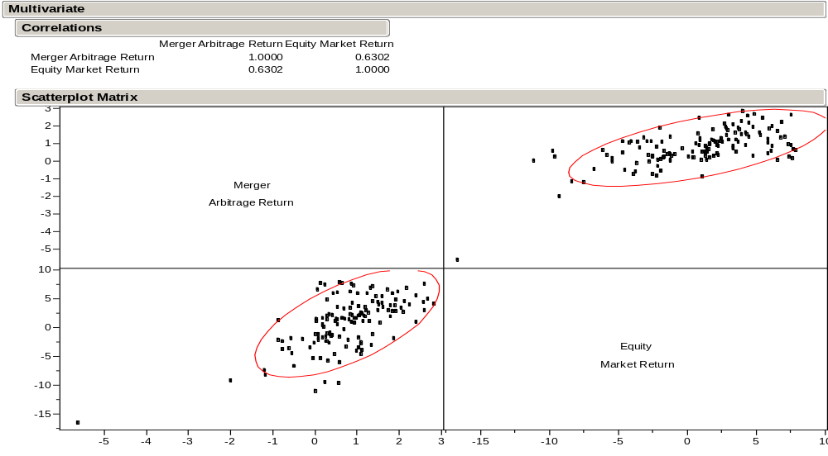
Merger Arbitrage
Correlation Properties
(1/1994 – 6/2005)
Source: Bonadurer (2006) based on CISDM and Datastream

Slide 78
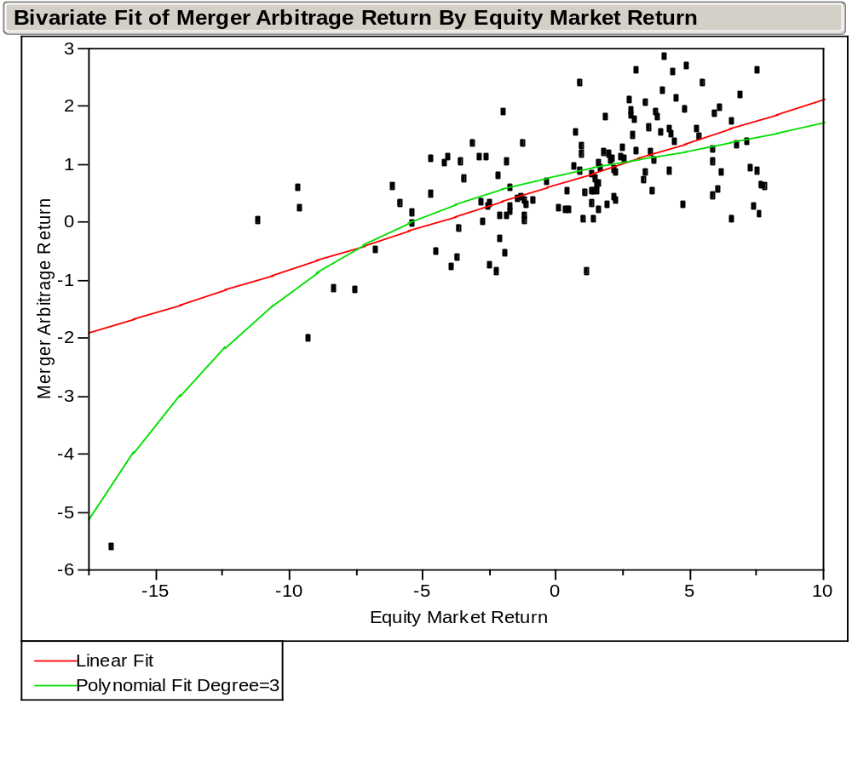
Merger Arbitrage
A Closer Look
Summary of Fit
R-square 0.48
RMSE 0.74
Observations 138
Preliminary Observations
Non-linear relationship?
(2) Merger Arbitrage performs well
in positive/flat markets and bad
in negative equity markets?
(3) If more data, similar payoff
as in short put situation?
Source: Bonadurer (2006) based on CISDM and Datastream

Slide 79
Short Put Option
Payoff Diagram
A put option gives its holder the right to sell an asset for
a specified exercise, or strike price,
on or before some expiration date
Payoff long put option
Payoff short put option
Profit
Profit
Strike
Premium
Price asset
Price asset
Premium
Strike
Loss
Loss

Slide 80

Merger Arbitrage
Risk and Return Properties
Returns merger arbitrage
+
Beta low;
market high
< 0.15
-
+
Returns equity market
Increase in
beta:
Beta high;
market low
> 0.50
(probability of
deal failure)
-
Modified and simplyfied from Mitchell and Pulvino (2001)
Negative equity market →
Less value target (in cash deal); often higher financing costs; less deal flow; bad sentiment; etc.

Slide 81
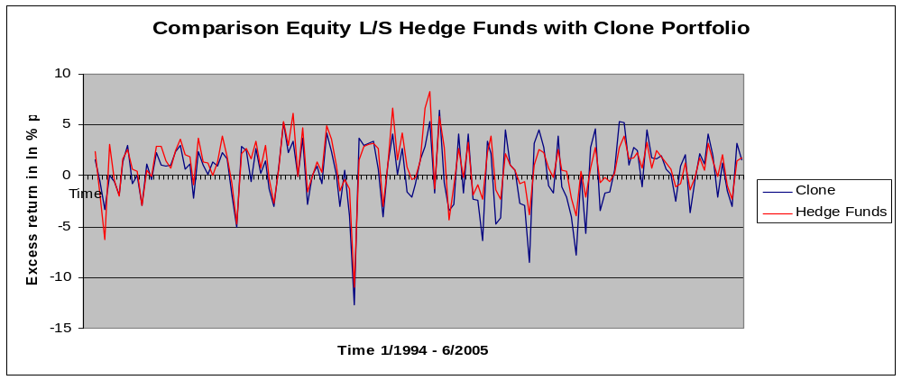
Performance Cloning Portfolio
(abbreviated and simplified)
Approximated cloning portfolio weights (0.6 RU3000 and 0.4 WSMBUS); fixed-weight
Average return hedge fund portolio > average return cloning portolio (same for Sharpe ratio)
Significance of difference in mean returns (t-test)?
Ability of linear cloning model to capture genuine alpha and/or nonlinear properties?
Ignored renormalization because of different volatility pattern/leverage

Slide 82
Equity Long/Short
Hedge Fund Investments
Range of trading strategies and potential proxies
Buy
and
Hold
Spread
Trading
Risk
Arbitrage
Convergence
Trading
Trend
Following
Other
Proxied by
range of
domestic/
international
equity markets
Proxied by
factors such as
HML, SMB,
MOM
Proxied by
portfolio of
short put options
on equity
markets
Proxied by
portfolio of
short straddle
options on
equity markets
Proxied by
portfolio of
long straddle
options on
equity markets
Proxied by
APT and other
asset class
factors
Potential risk exposures
Source: Bonadurer (2006)

Slide 83
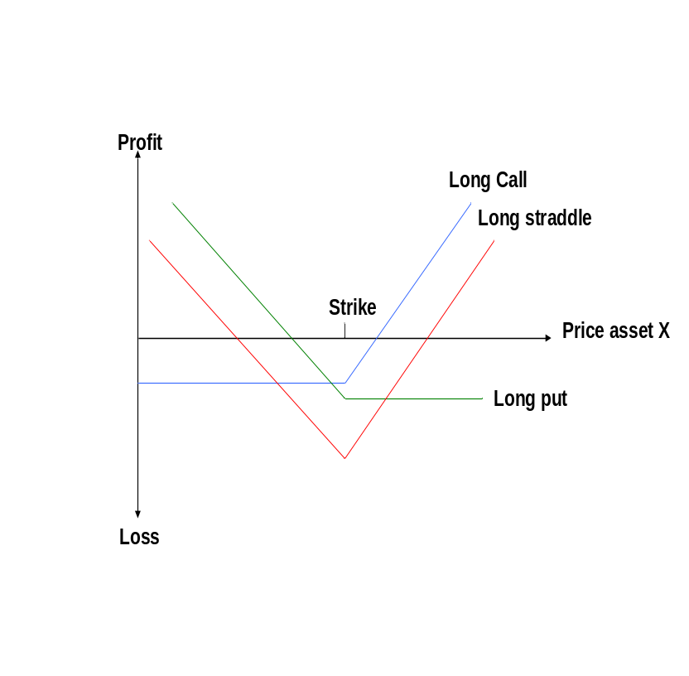
Trendfollowing – A Simple Proxy
(illustration only)
Price Development Asset X
Standard long straddle option
Asset X
Sell
+
Max. profit
Time
-
Buy
But use lookback straddle options instead...

Slide 84
Back Up Material

Slide 85
Short Selling Concept
Strongy simplified and illustrative only!
„Shorting“ involves selling an asset that is not owned
with
the intention of buying it back later (and cheaper)
Client
Broker
Investor
Open market
Source: Bonadurer 2006

Slide 86
Short Selling Concept
Strongy simplified and illustrative only!
„Shorting“ involves selling an asset that is not owned
with
the intention of buying it back later (and cheaper)
Client
Broker
Investor
1
Order to short sell 500 IBM
Open market
Source: Bonadurer 2006

Slide 87
Short Selling Concept
Strongy simplified and illustrative only!
„Shorting“ involves selling an asset that is not owned
with
the intention of buying it back later (and cheaper)
Client
Broker
Investor
2
1
Borrow 500 IBM
Order to short sell 500 IBM
Open market
Source: Bonadurer 2006

Slide 88
Short Selling Concept
Strongy simplified and illustrative only!
„Shorting“ involves selling an asset that is not owned
with
the intention of buying it back later (and cheaper)
Client
Broker
Investor
2
1
Borrow 500 IBM
Order to short sell 500 IBM
3
Sell 500 IBM
Open market
Source: Bonadurer 2006

Slide 89
Short Selling Concept
Strongy simplified and illustrative only!
„Shorting“ involves selling an asset that is not owned
with
the intention of buying it back later (and cheaper)
Client
Broker
Investor
2
1
Borrow 500 IBM
Order to short sell 500 IBM
3
Sell 500 IBM
Open market
4
Cash proceeds from sale
(margin account)
Source: Bonadurer 2006

Slide 90
Short Selling Concept
Strongy simplified and illustrative only!
„Shorting“ involves selling an asset that is not owned
with
the intention of buying it back later (and cheaper)
Client
Broker
Investor
2
1
Borrow 500 IBM
Order to short sell 500 IBM
3
Sell 500 IBM
Close out
Buy 500 IBM
5
Open market
4
Cash proceeds from sale
(margin account)
Cash
proceeds
to buy
Source: Bonadurer 2006

Slide 91
Short Selling Concept
Strongy simplified and illustrative only!
„Shorting“ involves selling an asset that is not owned
with
the intention of buying it back later (and cheaper)
6
Close out; return 500 IBM
Client
Broker
Investor
2
1
Borrow 500 IBM
Order to short sell 500 IBM
3
Sell 500 IBM
Close out
Buy 500 IBM
5
Open market
4
Cash proceeds from sale
(margin account)
Cash
proceeds
to buy
Source: Bonadurer 2006

Slide 92
Short Selling Concept
Strongy simplified and illustrative only!
„Shorting“ involves selling an asset that is not owned
with
the intention of buying it back later (and cheaper)
7
6
Close out; return 500 IBM
Close out; return 500 IBM
Client
Broker
Investor
2
1
Borrow 500 IBM
Order to short sell 500 IBM
3
Sell 500 IBM
Close out
Buy 500 IBM
5
Ignoring:
Dividends, margin requirements,
short rebates, transaction costs,
etc.
Open market
4
Cash proceeds from sale
(margin account)
Cash
proceeds
to buy
Source: Bonadurer 2006

Slide 93
Parity Example Using Gold
Strategy 1: Buy gold now at the spot price (S₀) and hold it until time T when it will be worth S_{T}
Strategy 2: Enter a long position in gold futures today and invest enough funds in T-bills (F₀) so that it will cover the futures price of S_{T}

Slide 94
Parity Example Outcomes
Strategy A: Action Initial flows Flows at T
Buy gold -So ST
Strategy B: Action Initial flows Flows at T
Long futures 0 ST - FO
Invest in Bill
FO/(1+rf)^T - FO/(1+rf)^T FO
Total for B - FO/(1+rf)^T ST

Slide 95
Price of Futures with Parity
Since the strategies have the same flows at time T
F_{O} / (1 + r_{f})^{T} = S_{O}
F_{O} = S_{O} (1 + r_{f})^{T}
The futures price has to equal the carrying cost of the gold

